Slide 1

Concurrency Bugs
PASS
CS532: OS Foundations
Lab Assignment
Email: chitram2@pdx.edu & ramya3@pdx.edu

Slide 2
Instructions: Make a copy of this document, move your copy to your submissions folder and fill the document with your responses. Use the space on each slide to show your responses, and add additional slides as needed.
When ready for grading: complete the lab assignment submission form and include a link to your filled document

Slide 3
1. When you wrote your helloT program, did you encounter (or create) any concurrency bugs? If so, then describe what type of concurrency bug(s) you encountered. Use the terminology from the reading/lecture, i.e., "Data Race", "Deadlock", "Order Violation", etc.
We got “DATA RACE” condition in which the variable factor is accessed by many threads. The section where factorial is being calculated is also the critical section being accessed by multiple threads at the same time.
We created a new program helloT2.c where we had introduced a mutex lock which protect the memory for multiple threads accessing it at the same time.
Yes, I agree that it was a data race. However, I’m not convinced that adding a mutex lock was the best solution.

Slide 4
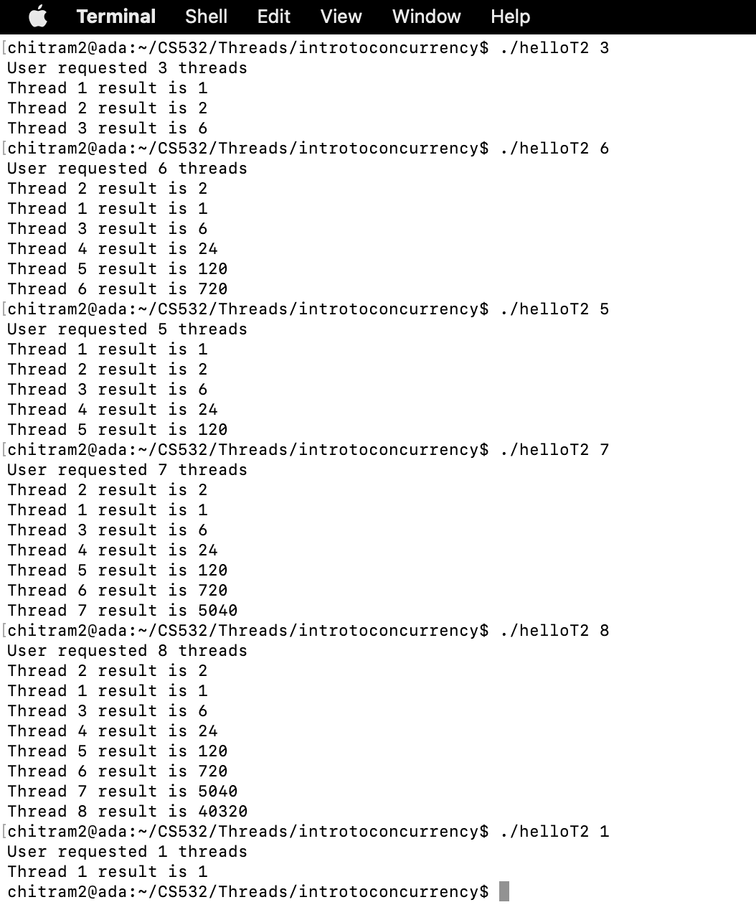
When Data Race is a common condition in concurrency. Order violation is also present in the helloT.c and helloT2.c but some results are calculated earlier than their previous results.For ex: In many cases, Thread2 calculates result earlier than Thread 1:
No order violation there. There was no requirement that the threads execute in any specific order.

Slide 5
2.
2A. The original sum program (from the Threads lab assignment) had a concurrency bug. What type of Concurrency bug did it have?
The original sum program was Data Race. Because all the threads were trying to access the same memory location simultaneously leading to faulty read/write operations for the variable which in turn produced faulty results.
Good

Slide 6
2B. You then created sum2.c. What type of Concurrency bug did sum2 have?
In Sum2 program, we have Excessive waiting is a type of concurrency bug. When total is being updated by thread1, other threads will have to wait unnecessarily to update Total.
Good

Slide 7
3. The original pingpong.c source code had a concurrency bug. What type of Concurrency bug did it have?
pingpong.c program has order violation and atomicity violation concurrency bugs with order violation is the dominant one.
When the pingpong.c program is run, then PING appears correctly.Due to the order violation, the desired order of memory access is flipped during concurrent execution. Therefore, pingpong.c results in error after first PING is printed.
OK

Slide 8
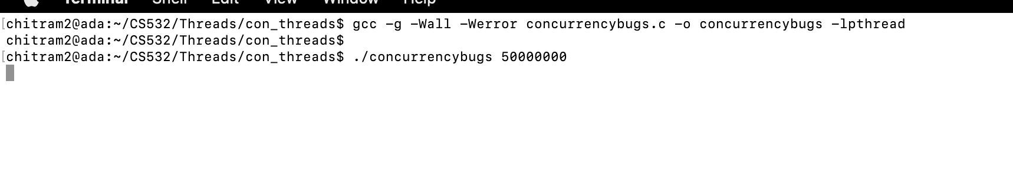
4. Build and run the provided bug4.c program which is linked from the course plan document.
Bug 4. C program stucks, when we ran

Slide 9
4A: What type of Concurrency bug does bug4 have?
Bug4.c program has Deadlock type of concurrency bug.When the two threads are created for two functions with mutex locks A and B,then we can have a deadlock.Because when first thread is run on the function doWork1(), then it acquires Mutex Lock A.By the time First Thread acquires Lock A, the second thread goes to the function doWork2() and it acquires Lock B.
While the Thread 1 moves forward, it will look for acquiring Lock B, but it is already acquired by the second thread. Hence, it will start waiting for the second thread to unlock the mutex lock B.Similarly, Second thread starts waiting for Lock A to be unlocked by the first Thread. This results in a deadlock.
Good

Slide 10
4B: Modify bug4.c to produce a new version, bug4_2.c that runs correctly. Test it thoroughly to convince yourself that your new version is functioning correctly. Upload bug4_2.c to your submission folder and provide a link to it here: link
https://docs.google.com/document/d/1nxQyPksFK3yJ3urWJocx6g6ne-NRjQze/edit

Slide 11
#include <stdio.h>
#include <stdlib.h>
#include <pthread.h>
#include <unistd.h>
#define SLEEPTIME 5
volatile unsigned long counter = 0;
unsigned long numloops;
pthread_mutex_t mutexA = PTHREAD_MUTEX_INITIALIZER;
pthread_mutex_t mutexB = PTHREAD_MUTEX_INITIALIZER;
void *dowork1(void *param)
{
for (int i = 0; i < numloops; i++) {
pthread_mutex_lock(&mutexA);
pthread_mutex_lock(&mutexB);
counter++;
if ((counter % 1000000) == 0) {
printf("WORKER1: %ld\n", counter);
}
pthread_mutex_unlock(&mutexB);
pthread_mutex_unlock(&mutexA);
}
return NULL;
}
Code looks good. I like how you nested the mutex locks.

Slide 12
void *dowork2(void *param)
{
for (int i = 0; i < numloops; i++) {
pthread_mutex_lock(&mutexA);
pthread_mutex_lock(&mutexB);
counter++;
if ((counter % 1000000) == 0) {
printf("WORKER2: %ld\n", counter);
}
pthread_mutex_unlock(&mutexB);
pthread_mutex_unlock(&mutexA);
}
return NULL;
}
int main(int argc, char **argv) {
if (argc != 2) {
fprintf(stderr, "USAGE: %s <size>\n", argv[0]);
exit(-1);
}
numloops = atol( argv[1] );
pthread_t w1, w2;
pthread_create(&w1, NULL, dowork1, NULL);
pthread_create(&w2, NULL, dowork2, NULL);
pthread_join(w1, NULL);
pthread_join(w2, NULL);
printf("FINISHED: counter == %ld\n", counter);
return 0;
}

Slide 13
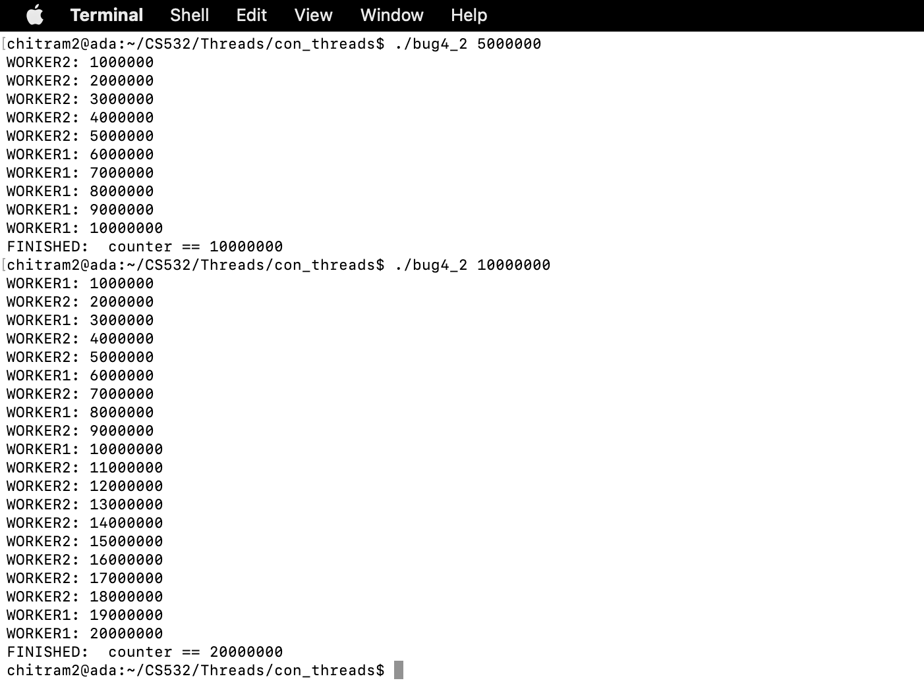

Slide 14
